Slide 1
Democratizing high-dimensional stochastic workflows
Jeremy White

Slide 2
Why?
Two necessary conditions for decision-support modeling:
1 high-dimensional: avoid erroneous decision making
2 stochastic: express reliability in simulated outcomes
Knowling and others (2019). Role of model parameterization in risk-based decision support: An empirical exploration

Slide 3
Why?
Two necessary conditions for decision-support modeling:
1 high-dimensional: avoid erroneous decision making
2 stochastic: express reliability in simulated outcomes
Democratizing: increase efficiency and convenience

Slide 4
Why?
Two necessary conditions for decision-support modeling:
1 high-dimensional: avoid erroneous decision making
2 stochastic: express reliability in simulated outcomes
Democratizing: increase efficiency and convenience
One way to do this: iterative ensemble smoothers (IES)

Slide 5
the IES algorithm (efficiency )
P ( ne x npar)
D_{sim} ( ne x nobs)
 | hk | rech | sconc
real1 | 0.123 | 1101 | 12.3
real2 | 0.321 | 1234 | 32.1
real3 | 0.987 | 2001 | 69.0
realN | 0.789 | 1959 | 54.1
 | head | conc | flux
real1 | 1.11 | 0.0001 | 3.21
real2 | 2.22 | 0.003 | 1.23
real3 | 3.33 | 0.0003 | 9.6
realN | 4.44 | 0.001 | 1.45
model runs = ne (number reals)
(e.g. Monte Carlo)

Slide 6
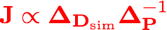

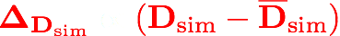
the IES algorithm
P ( ne x npar)
D_{sim} ( ne x nobs)
 | hk | rech | sconc
real1 | 0.123 | 1101 | 12.3
real2 | 0.321 | 1234 | 32.1
real3 | 0.987 | 2001 | 69.0
realN | 0.789 | 1959 | 54.1
update via GLM
(e.g. maths)
 | head | conc | flux
real1 | 1.11 | 0.0001 | 3.21
real2 | 2.22 | 0.003 | 1.23
real3 | 3.33 | 0.0003 | 9.6
realN | 4.44 | 0.001 | 1.45
model runs = ne (number reals)
(e.g. Monte Carlo)

Slide 7
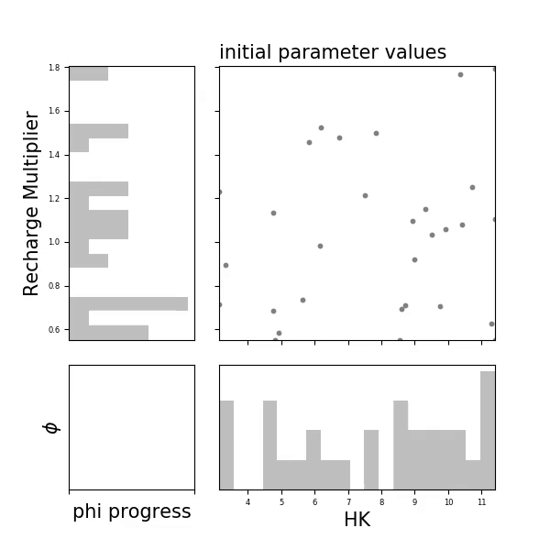
PESTPP-IES
(Convenience)
ensemble-space upgrades
advanced localization
multithreaded and parallel
interoperable with PEST(_HP)
Documentation!
github.com/usgs/pestpp
White (2018). A model-independent iterative ensemble smoother for history matching and uncertainty quantification in very high dimensions.

Slide 8
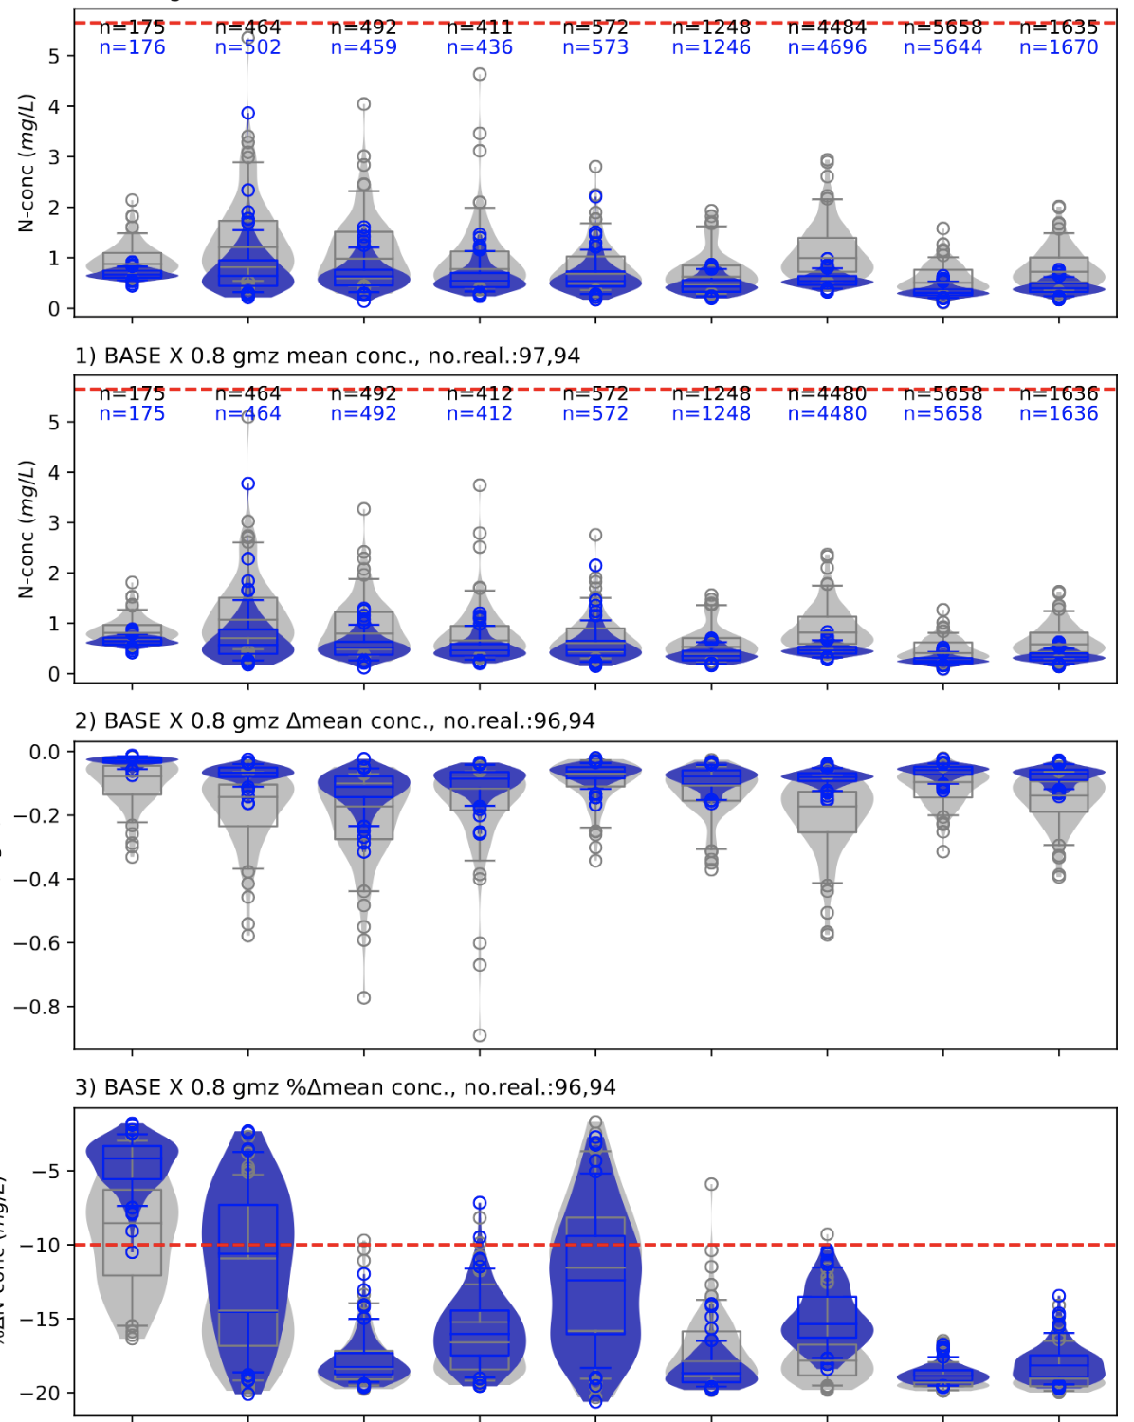
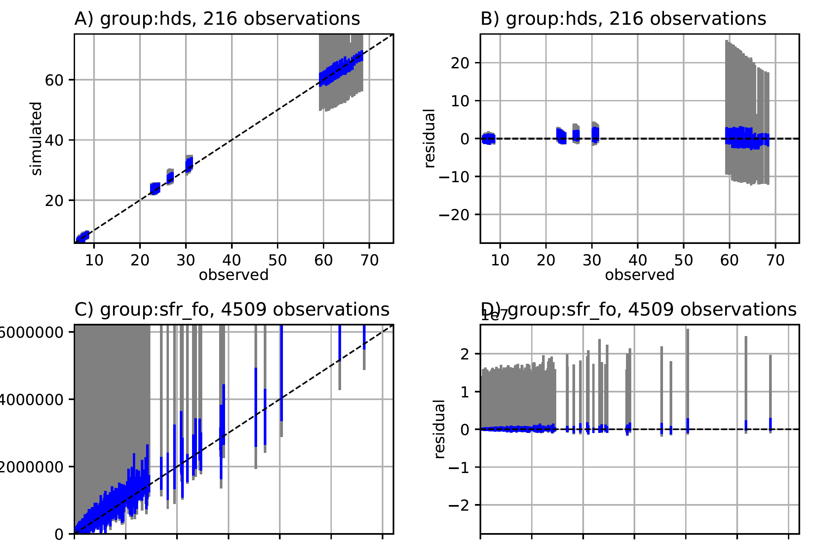
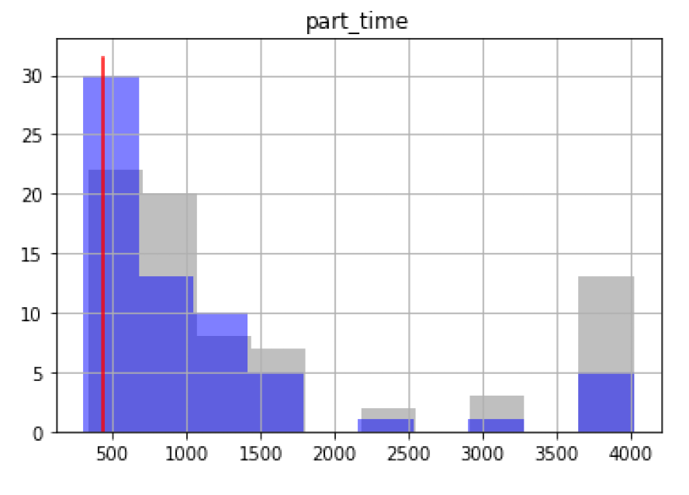
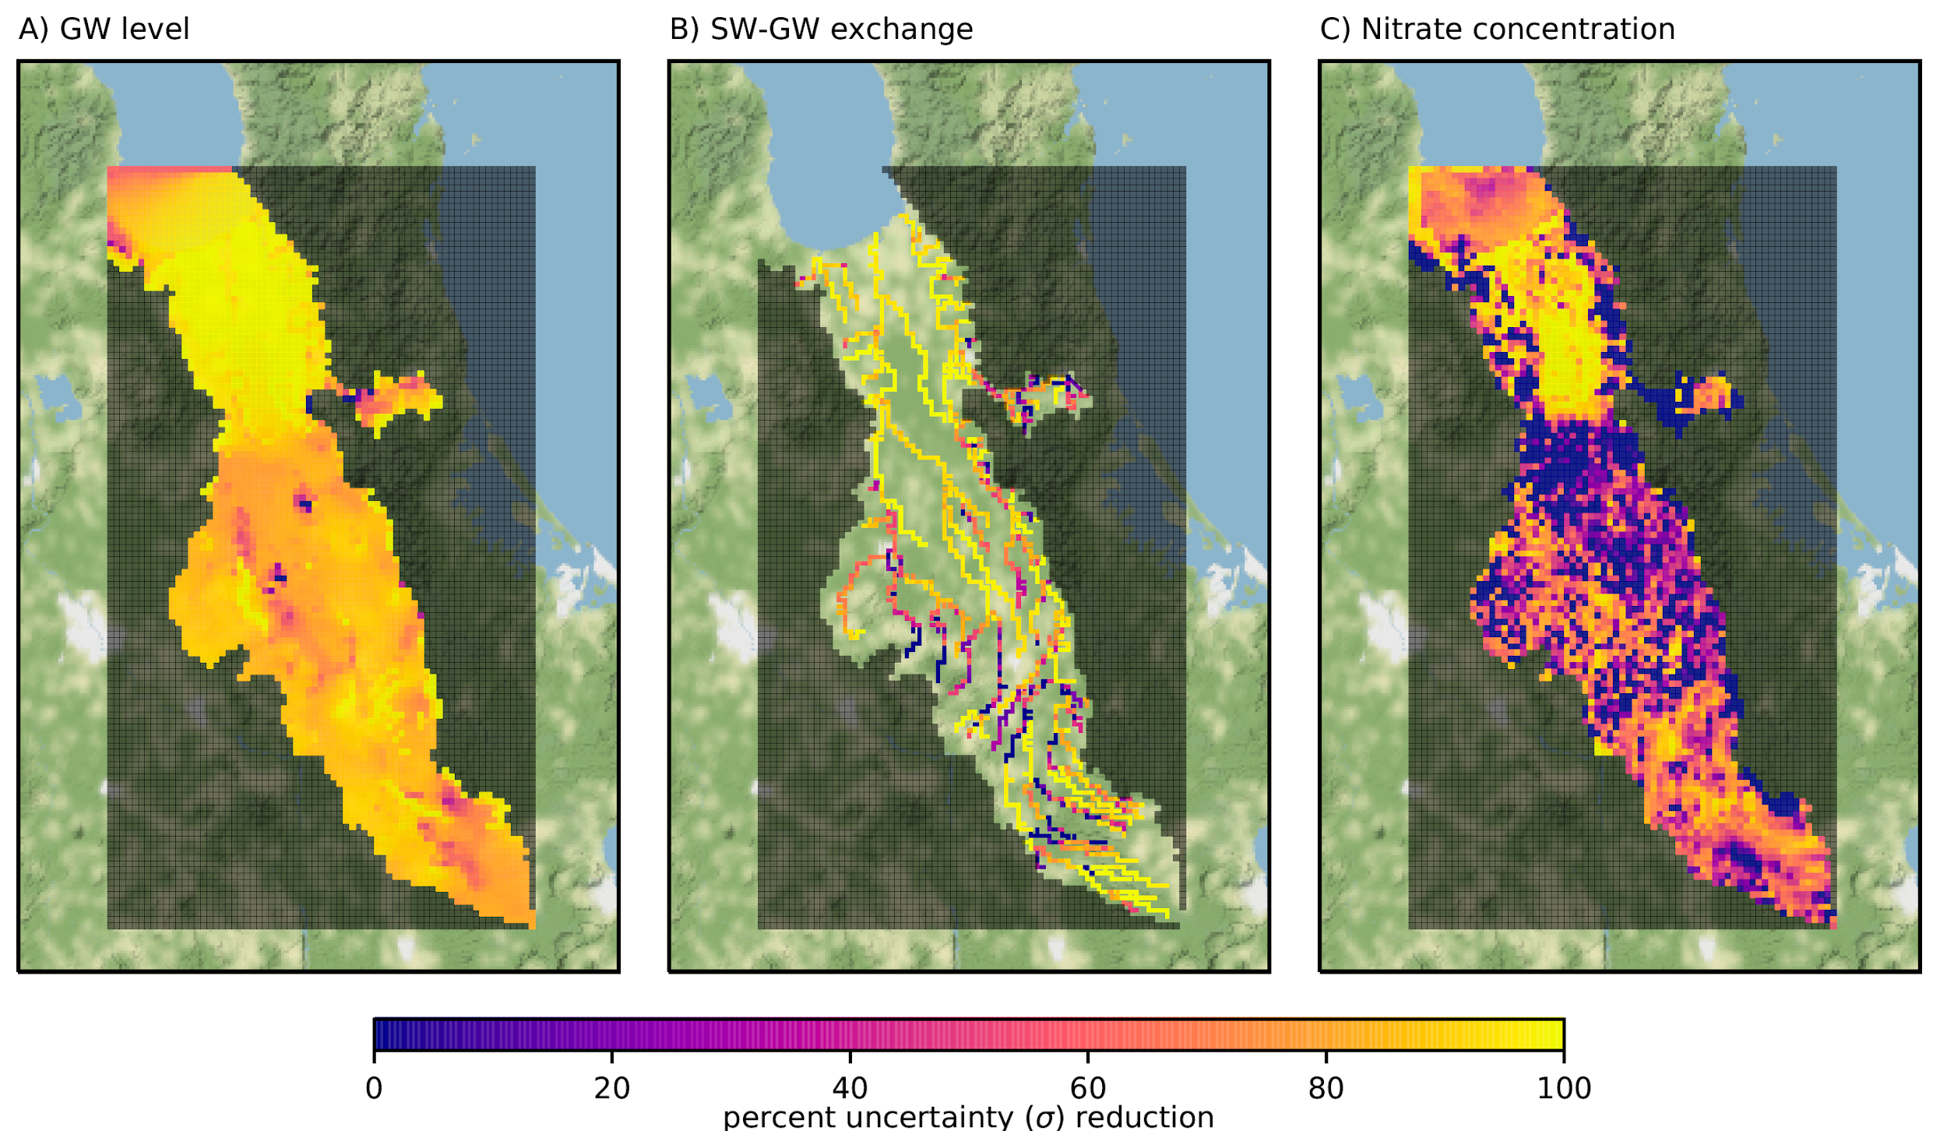
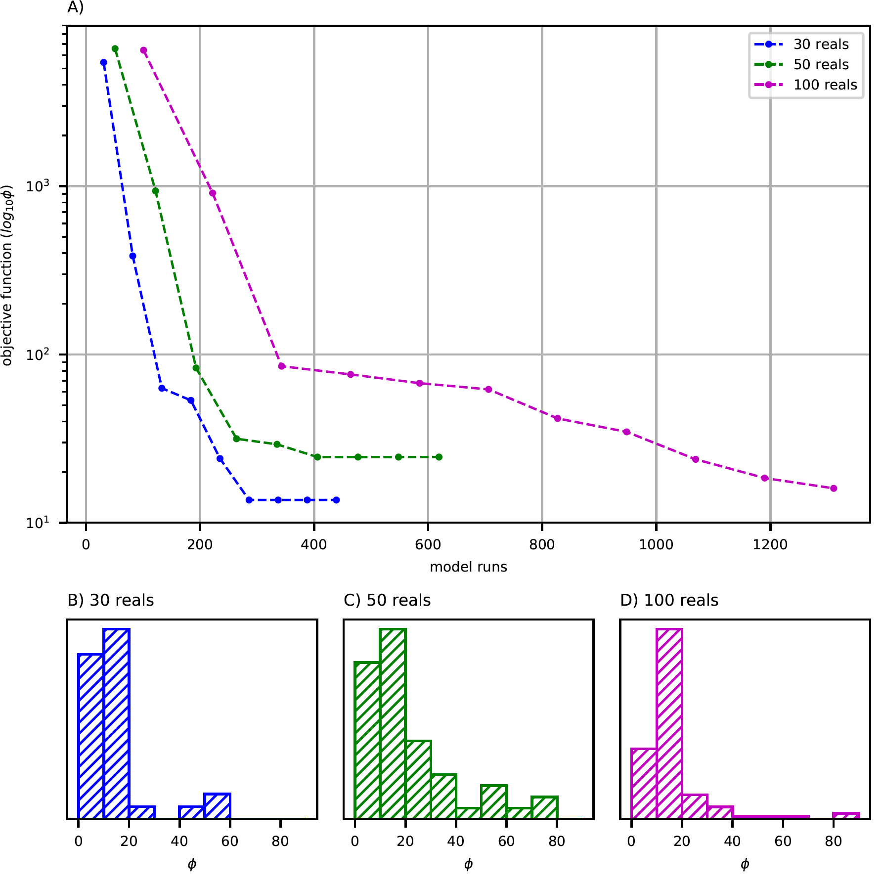
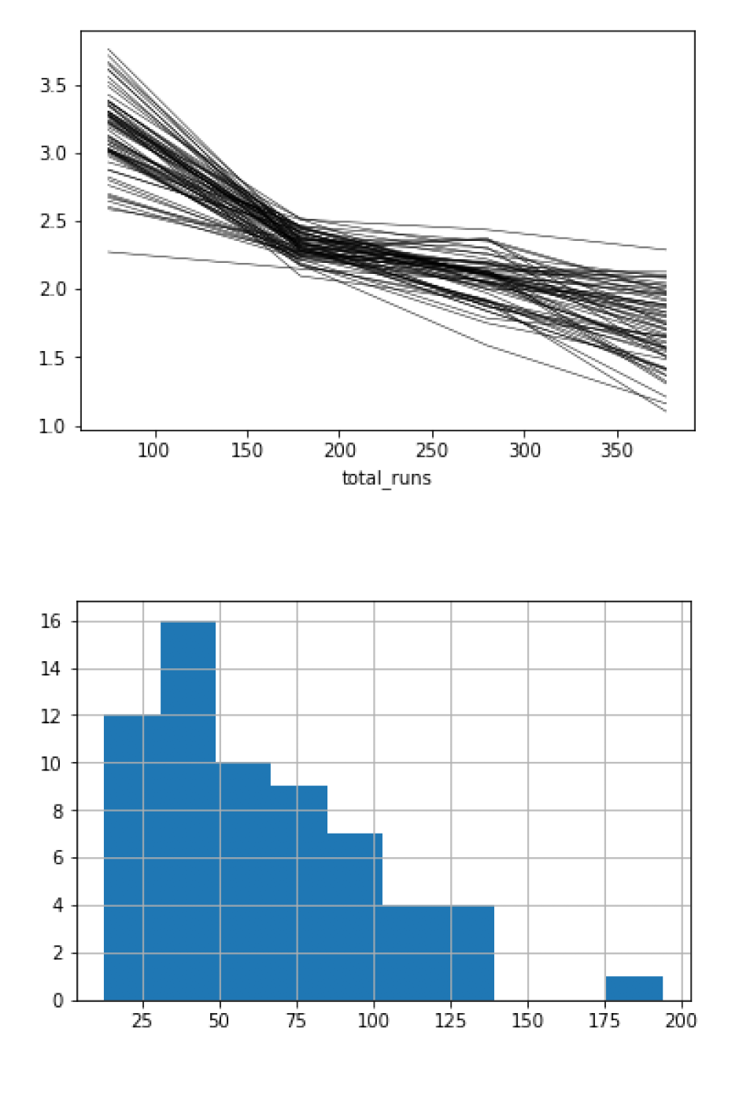
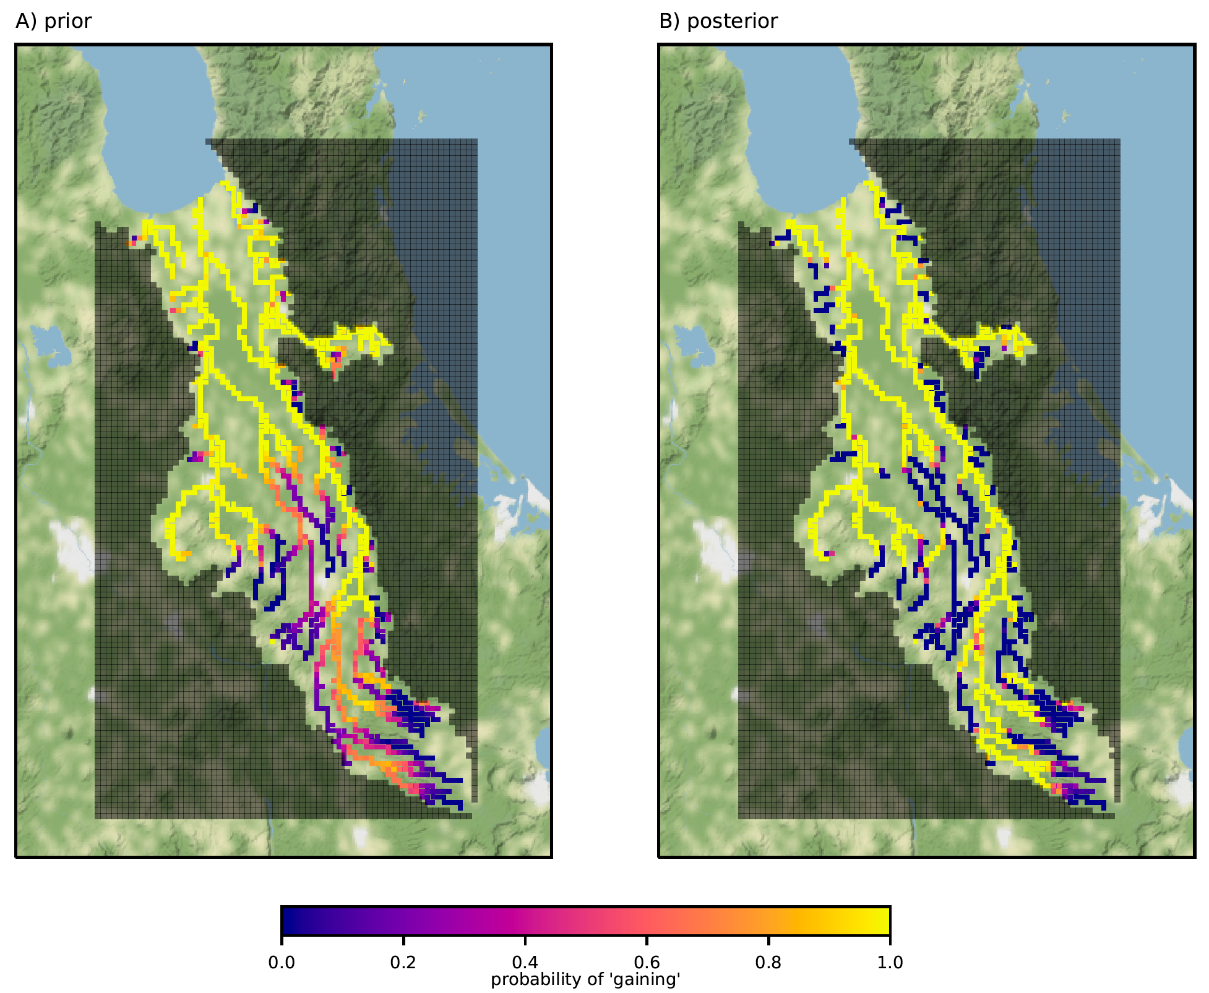
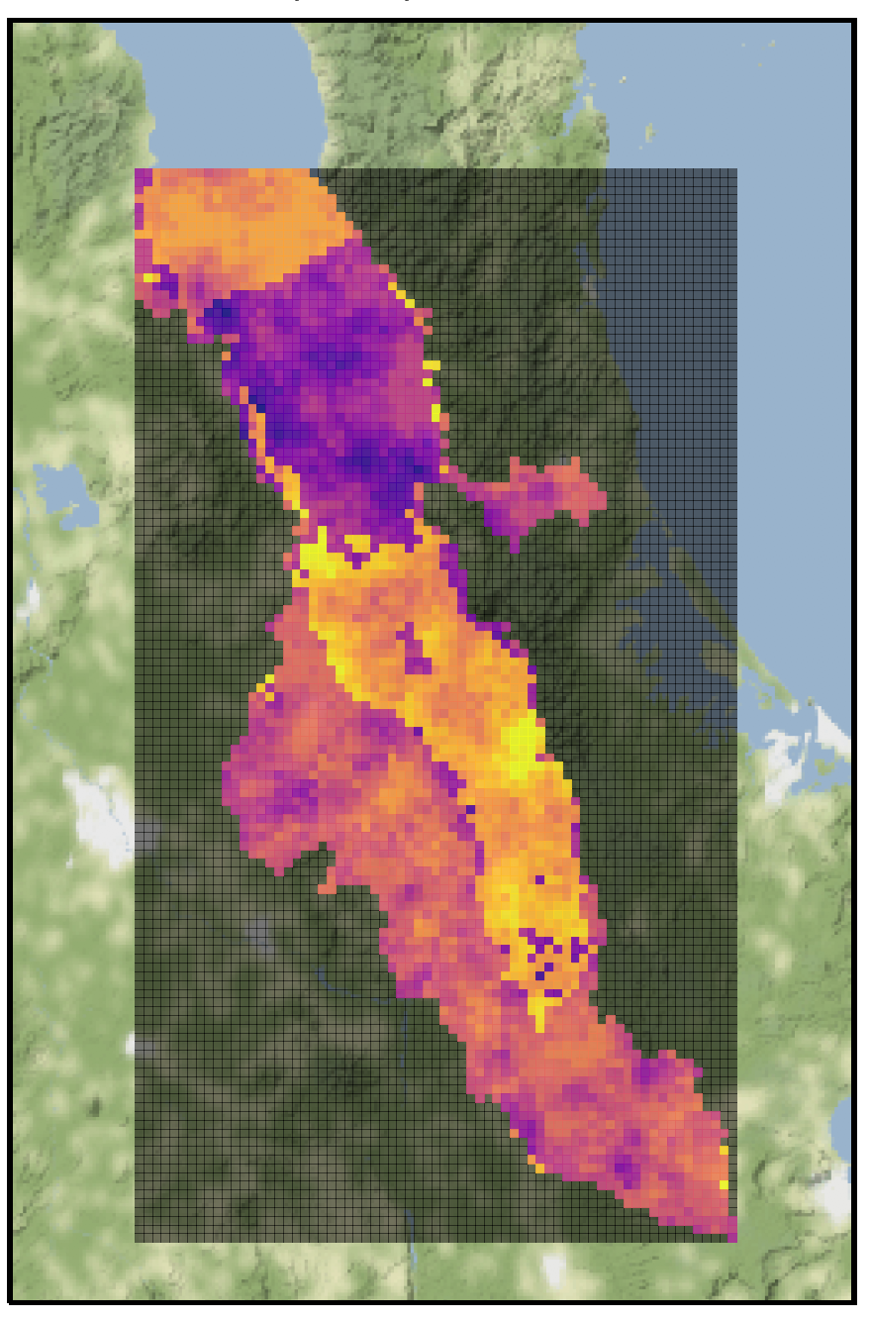
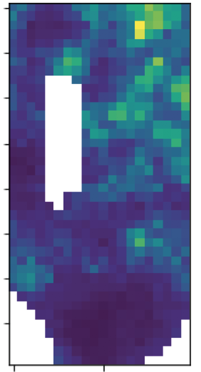
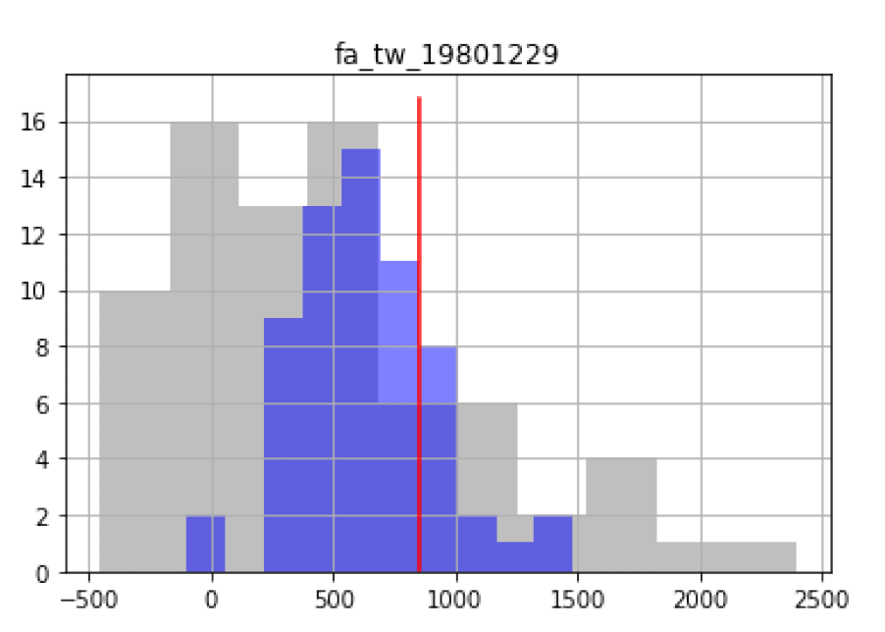
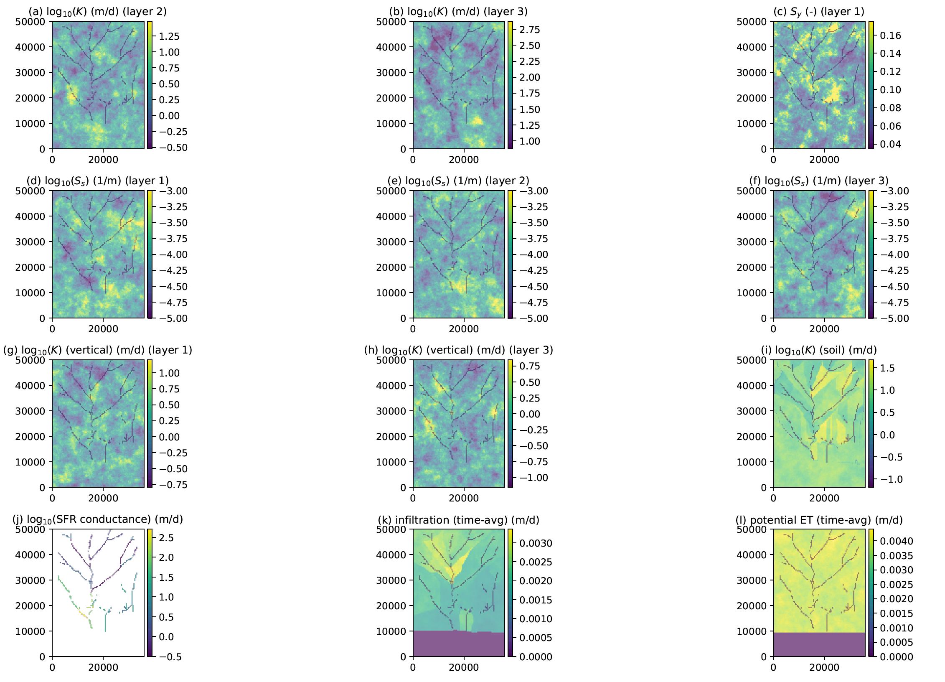
Just sayin...
Notes:
The real power of ies is not just doing what we do now better, but the convenience and efficiency of ies lets us peel back another layer - towards real-world model error detection and coping

Slide 9
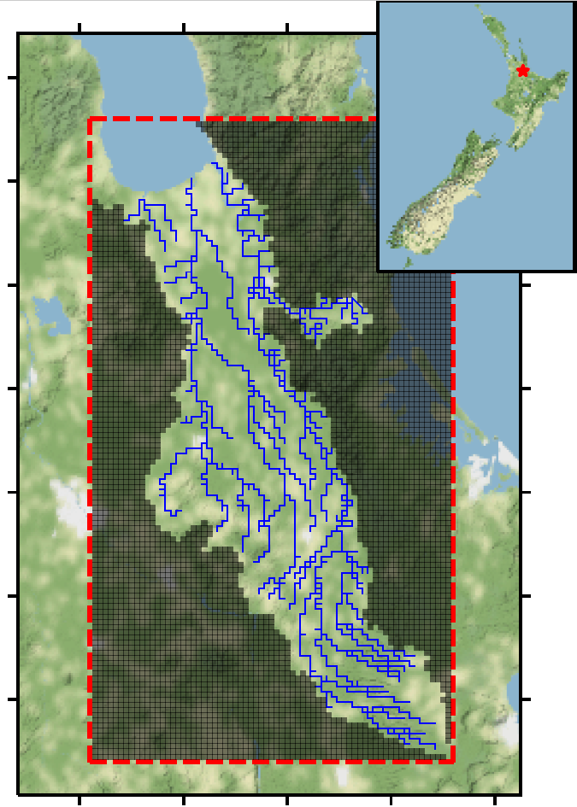
Hauraki Plains, NZ
Purpose: regional-scale, policy-level land-use changes
Entire workflow is scripted!
MFNWT + MT3D-USGS (Tr + N)
7 layers, transient, blah,blah,blah
170K parameters
Grid scale,stress-period scale
5k GW level, 5k SW flow
100 realizations, 3 iterations
400ish runs
Notes:
Inner iterations

Slide 10
Model error coping part 1:
Detecting and resolving prior-data conflict

Slide 11
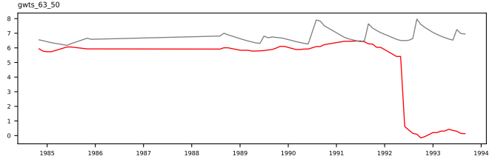
well-posed, deterministic setting
uncalibrated
(1 model run)
observed
Notes:
Ignorance is bliss

Slide 12
well-posed, deterministic setting
uncalibrated
(1 model run)
observed
Is this ok?
Notes:
Ignorance is bliss

Slide 13
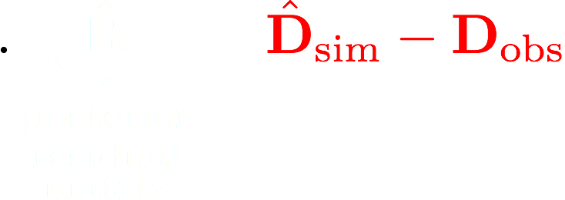
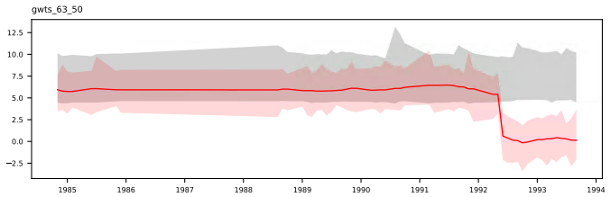

High-dimensional stochastic setting
Prior (maximum uncertainty) range
(100 model runs)
Observed + noise range
Notes:
Outputs directly from pestpp-ies - convenience and efficiency

Slide 14

High-dimensional stochastic setting
Prior (maximum uncertainty) range
(100 model runs)
Observed + noise range
Notes:
Outputs directly from pestpp-ies - convenience and efficiency

Slide 15

prior-data conflict
Throw out observations
(∴higher posterior variance)
Revisit underlying model
(req: $$$, time, skills)
(∴lower posterior variance)
Evans and Moshonov (2006). Checking for prior-data conflict

Slide 16

prior-data conflict
Throw out observations
(∴higher posterior variance)
Revisit underlying model
(req: $$$, time, skills)
(∴lower posterior variance)
Evans and Moshonov (2006). Checking for prior-data conflict

Slide 17

Theory and maths
I collected those data and they therefore are important

Slide 18
Model error coping part 2:
Hyper-parameters and “outer iterations”
Notes:
Ignorance is bliss

Slide 19
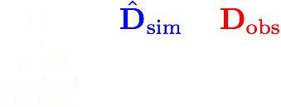
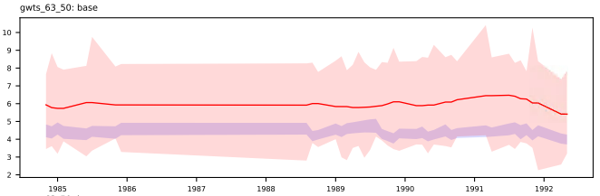
High-dimensional stochastic setting
Observed + noise range
Posterior range
Notes:
Resolve PDC then run pestpp-ies a set of inner iterations

Slide 20
Maybe I should add more parameters???
Maybe I should change the parameters more???
?
Maybe something is wrong with the observation data???
Maybe something is wrong with the model???
User error???
Notes:
Forming the outer iteration problem

Slide 21
Maybe I should add more parameters???
Maybe I should change the parameters more???
Maybe something is wrong with the observation data???
Maybe something is wrong with the model???
User error???
Notes:
The noise matrix is the second moment of the likelihood function

Slide 22

Total Error Covariance and hyper-parameters:
Observed + noise range
Posterior range
Oliver and Alfonso (2018). Calibration of imperfect models to biased observations
Notes:
Calculation applied to all residuals simultaneously

Slide 23

Total Error Covariance and hyper-parameters:
“That’s like two lines of python”

Slide 24
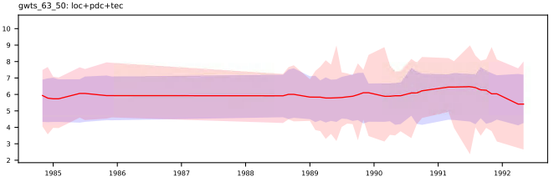

Results
Observed + noise range
Posterior range
Notes:
Rerun pestpp-ies for the next set of inner iterations. This is where the convience and efficiency of ies is critical

Slide 25
Summary
Prior-data conflict detection and resolution is critical
Total error covariance workflow is one way to reduce biases from model error
IES makes high-dimensional stochastics efficient and convenient
Notes:
The convenience and efficiency of ies allows us to easily implement high-dimen stoch workflows, leading to higher-order analyses

Slide 26
Questions?
github.com/usgs/pestpp

Slide 27
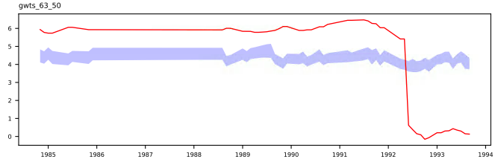
Before and after...
Notes:
From a regional-scale and policy-level decision making standpoint, this is a much better place to be:

Slide 28
Towards non-intrusive closed-loop resource mgmt
PstFrom()
Next gen automated interface construction
Brioch Hemmings
Moouu
multiobjective optimization under uncertainty
Otis Rea
Ennlouu
Large-scale ensemble-based SQP under uncertainty
Matt Knowling
EnKF
Non-intrusive (PEST) framework for sequential DA
Ayman Alzraiee (poster tonight!!!)

Slide 29
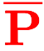
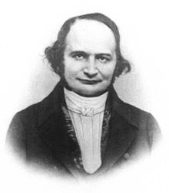
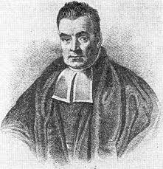
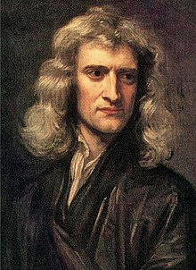
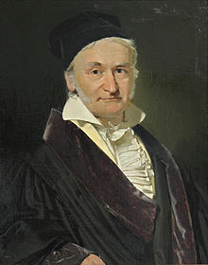
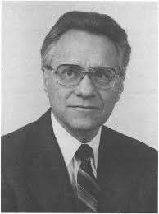
Iterative Ensemble Smoother
P ( ne x npar)
D_{sim} ( ne x nobs)
 | hk | rech | sconc
real1 | 0.123 | 1101 | 12.3
real2 | 0.321 | 1234 | 32.1
real3 | 0.987 | 2001 | 69.0
realN | 0.789 | 1959 | 54.1
 | head | conc | flux
real1 | 1.11 | 0.0001 | 3.21
real2 | 2.22 | 0.003 | 1.23
real3 | 3.33 | 0.0003 | 9.6
realN | 4.44 | 0.001 | 1.45
model runs = ne (number reals)
(e.g. Monte Carlo)
 | 0.51 | 1751 | 31.4
 | 3.35 | 0.002 | 4.51

Slide 30
Iterative Ensemble Smoother
P ( ne x npar)
D_{sim} ( ne x nobs)
 | hk | rech | sconc
real1 | 0.123 | 1101 | 12.3
real2 | 0.321 | 1234 | 32.1
real3 | 0.987 | 2001 | 69.0
realN | 0.789 | 1959 | 54.1
 | head | conc | flux
real1 | 1.11 | 0.0001 | 3.21
real2 | 2.22 | 0.003 | 1.23
real3 | 3.33 | 0.0003 | 9.6
realN | 4.44 | 0.001 | 1.45
model runs = ne (number reals)
(e.g. Monte Carlo)
 | 0.51 | 1751 | 31.4
 | 3.35 | 0.002 | 4.51

Slide 31
Iterative Ensemble Smoother
P ( ne x npar)
D_{sim} ( ne x nobs)
 | hk | rech | sconc
real1 | 0.123 | 1101 | 12.3
real2 | 0.321 | 1234 | 32.1
real3 | 0.987 | 2001 | 69.0
realN | 0.789 | 1959 | 54.1
 | head | conc | flux
real1 | 1.11 | 0.0001 | 3.21
real2 | 2.22 | 0.003 | 1.23
real3 | 3.33 | 0.0003 | 9.6
realN | 4.44 | 0.001 | 1.45
model runs = ne (number reals)
(e.g. Monte Carlo)
 | 0.51 | 1751 | 31.4
 | 3.35 | 0.002 | 4.51

Slide 32
P ( ne x npar)
D_{sim} ( ne x nobs)
 | hk | rech | sconc
real1 | 0.123 | 1101 | 12.3
real2 | 0.321 | 1234 | 32.1
real3 | 0.987 | 2001 | 69.0
realN | 0.789 | 1959 | 54.1
update via GLM
(e.g. maths)
 | head | conc | flux
real1 | 1.11 | 0.0001 | 3.21
real2 | 2.22 | 0.003 | 1.23
real3 | 3.33 | 0.0003 | 9.6
realN | 4.44 | 0.001 | 1.45
model runs = ne (number reals)
(e.g. Monte Carlo)
 | 0.51 | 1751 | 31.4
 | 3.35 | 0.002 | 4.51

Slide 33
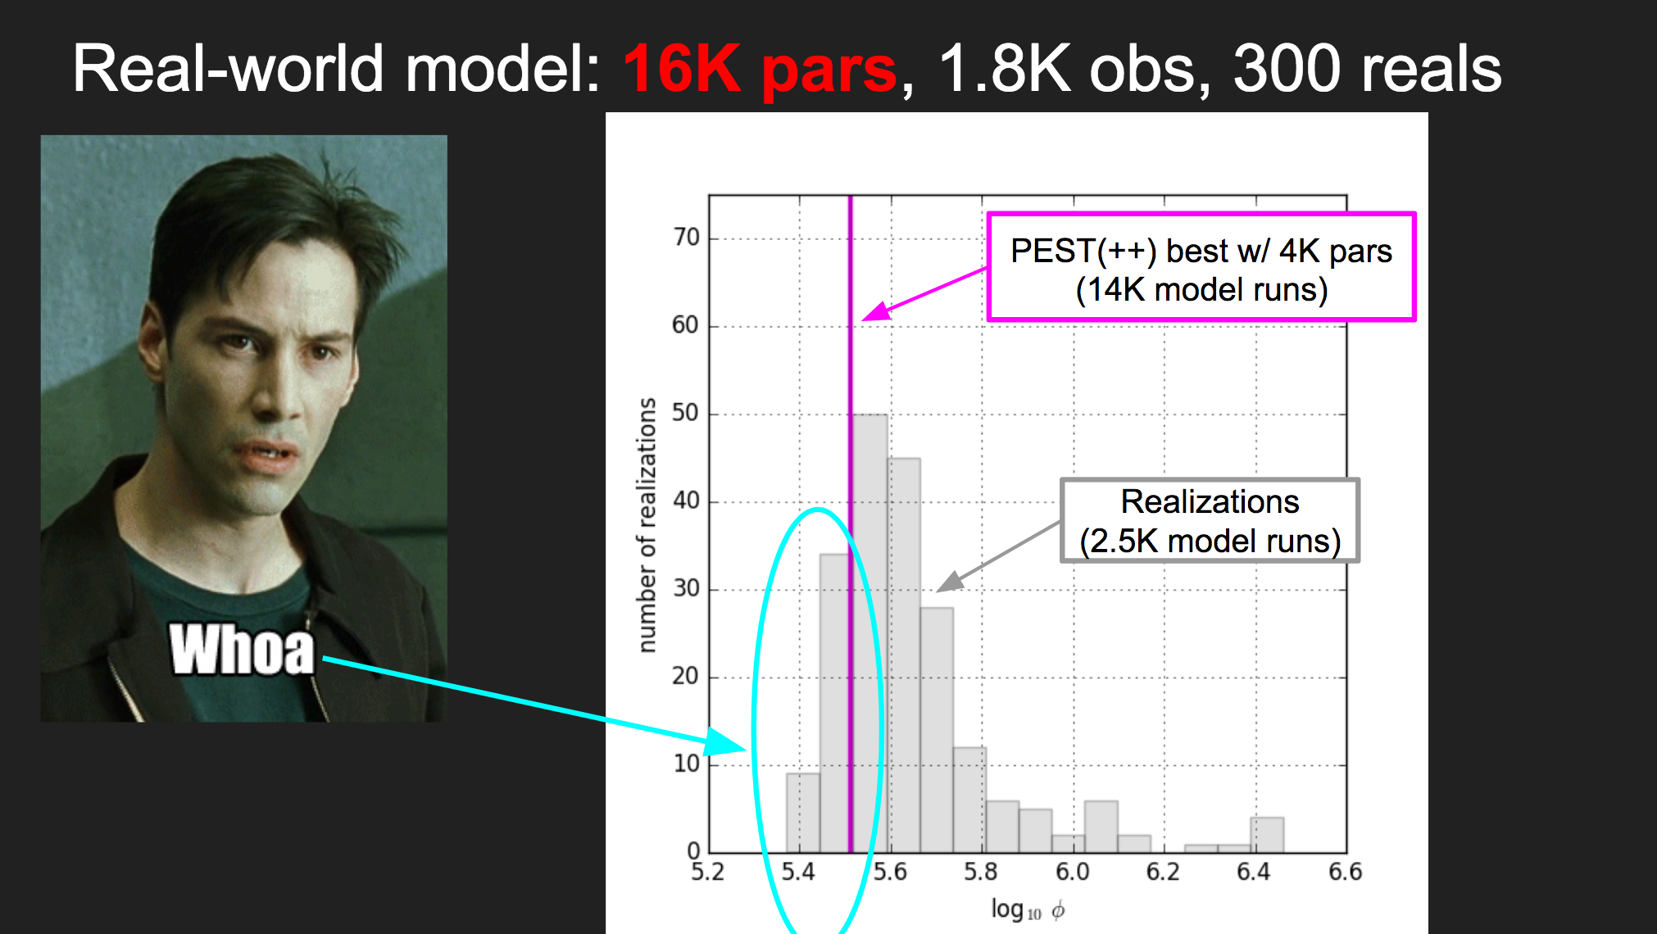
Example application
...two years ago...

Slide 34
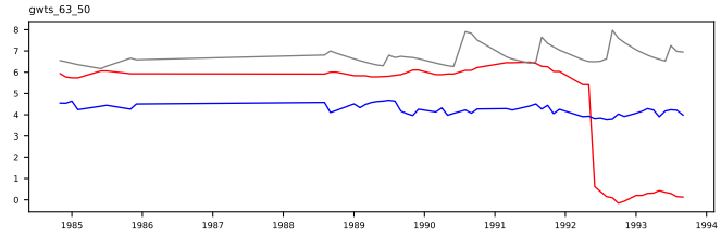
Step back: well-posed, deterministic setting
uncalibrated
observed
“calibrated”
Notes:
To an earlier, simpler time

Slide 35
Maybe I should change the parameters more???
Maybe I should add more parameters???
uncalibrated
observed
Maybe something is wrong with the observation data???
“calibrated”
Maybe something is wrong with the model???
User error???
Notes:
An ill-posed outer iteration problem!

Slide 36

Maybe I should change the parameters more???
Maybe I should add more parameters???
uncalibrated
WHAT SHOULD I DO????
observed
Maybe something is wrong with the observation data???
“calibrated”
Maybe something is wrong with the model???
User error???
Notes:
An ill-posed outer iteration problem!

Slide 37
Bias Minimization Workflow (BMW)
Goal: minimize the ill-effects of model error
Sufficient condition: optimal for regional-scale broad-purpose models
Heaps of parameters, bru! (and stochastics)
Prior (unconstrained) Monte Carlo
Prior-data conflict detection and resolution
unconstrained Monte Carlo/throw out observations (red pill!)
Rigorous “outer iterations”
Notes:
This is where the efficiency of ies is critical.

Slide 38
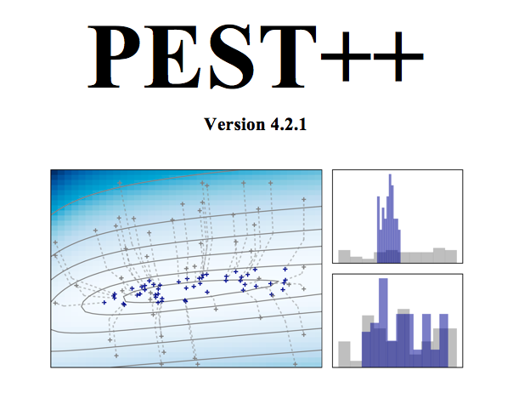
PESTPP-IES implementation
ensemble-space upgrades (up to 15M pars)
advanced localization capabilities
“very very dark art” - J Doh
multithreaded upgrades and parallel run mgmt
completely interoperable with PEST(_HP)
Documentation!
github.com/usgs/pestpp
PC, Mac, *nix
Help Wanted!!!
Luo and Bakhta (2018). Towards Automatic And Adaptive Localization For Ensemble-Based History Matching
Notes:
sherman-morrison-woodbury matrix identity to avoid allocating very large matrices

Slide 39


From go to whoa: pyemu.helpers.PstFromFlopyModel()
MF2005 family (more coming…)
Setup huge numbers of parameters and observations
Geostatistical covariance/draws
forward_run.py (that’s so meta!)
...
helps recover from and/or
github.com/jtwhite79/pyemu

Slide 40
Issues with applying PESTPP-IES in high-dimensional, real world settings
(in addition to all the other problems we face)
Hydrologic modeling: MODEL INSTABILITY!!!
Partial solution: greedy run mgmt, looser tolerances
Small ensembles: ensemble collapse/spurious correlations
Solution: localization
Mechanics: handling ensembles of large numbers of parameters
Solution: “That’s like two lines of python”

Slide 41

This is gonna be sweet az, bru!

Slide 42
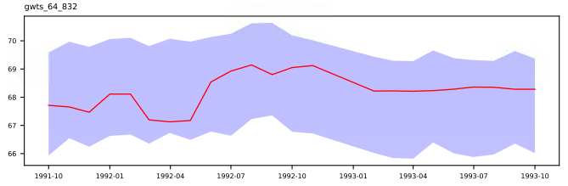
A naive assessment - a GW level time series
posterior range
observed

Slide 43
A different GW level time series
posterior range
observed
Notes:
focus on this GW timeseries. Ies, just like any other model-partner software, can only answer the question you ask it. However, high-dimen stoch workflows can help you more rapidly indent and resolve issues - “outer iterations” to refine the question

Slide 44
Example applications
(motivation for high-dimensional stochastic workflows)

Slide 45
well-posed, deterministic setting
uncalibrated
observed
“calibrated”
Notes:
To an earlier, simpler time

Slide 46
Maybe I should change the parameters more???
Maybe I should add more parameters???
uncalibrated
?
observed
Maybe something is wrong with the observation data???
“calibrated”
Maybe something is wrong with the model???
User error???
Notes:
An ill-posed outer iteration problem!

